Slide 2
Business Disruption in the Age of COVID: How to Use Force Majeure Clauses and Insurance Claims to Enhance Recovery
November 10, 2020
9 a.m. – 12 p.m.

Slide 3
Enhancing Recovery and Minimizing Loss: Force Majeure and Business Interruption in the Age of COVID-19
Joyce A. Kuhns, Esquire
Offit Kurman, P.A.
300 East Lombard Street, Suite 2010
Baltimore, MD 21202
T: (410) 209-6463
jkuhns@offitkurman.com

Slide 4
Joyce A. Kuhns, Esq. Offit Kurman, P.A.
Principal in Firm's Creditors Rights, Reorganization and Bankruptcy
Practice based in its Baltimore Office.
Significant experience at the regional and national level in workouts,
bankruptcies, refinancings, and restructurings representing creditors,
debtors, receivers, liquidating trustees, creditors and equity
committees, and regulators.
Served as a member on the Maryland Commercial Receivership
Committee and testified on behalf of the Maryland Commercial
Receivership Act before both Houses of the Maryland General Assembly.
President, William and Mary Law School Foundation Board.
Member, American Bankruptcy Institute.
Member, International Council of Shopping Centers, Bankruptcy Task Force, since 1997.
Recognized annually in The Best Lawyers in America list in Bankruptcy/Creditor-Debtor Rights and Reorganization, and Bankruptcy Litigation since 2007.
Recognized annually in Maryland Super Lawyers in Bankruptcy since 2008.
Recognized as one of The Top 100 Women in Maryland by The Daily Record.
Testified multiple times before Congress on key legislation in the restructuring industry.

Slide 5
Precipitating Events
WHO declares COVID-19 a worldwide pandemic – 3/11/2020
President Trump declares national emergency – 3/13/2020
State after state, Governors issue Executive Orders ranging from stay-at-home mandates excepting essential service providers to suspension of services at all businesses that offer food or beverages for on-site consumption but permitting services that facilitate off-site consumption such as in-house delivery, third-party delivery, drive-throughs, and curbside pick-up, while maintaining adequate social distancing between staff and patrons.

Slide 6
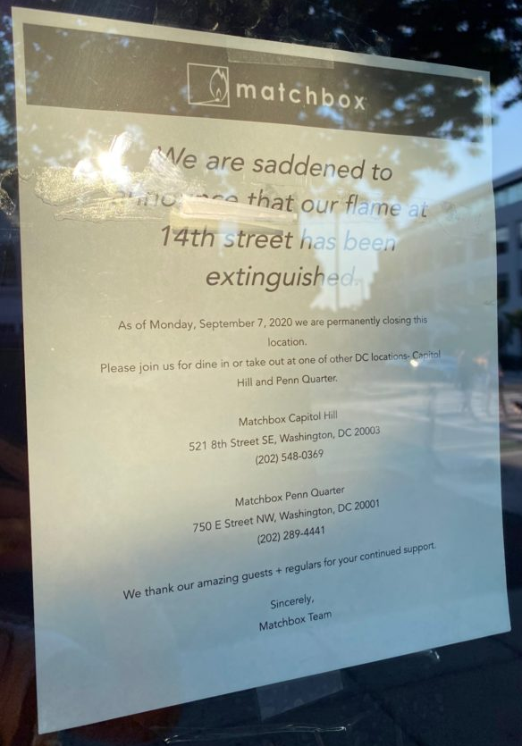
Brick and mortar retailers, especially
restaurants, bars and fitness centers,
were disproportionately, negatively
impacted by COVID-19 edicts.
Major disruptions occurred throughout
the retail supply chain.
Shut-downs significantly disrupted
payment of commercial lease
obligations across the United States.
Retailers with household names such as: J. Crew, Hair Cuttery, Matchbox, 24 Hour Fitness – all in our geographic backyard –sought relief from COVID-19 in the Bankruptcy Court.

Slide 7
Pertinent Bankruptcy Provisions
Section 365 of Title 11 of the United States Code (the “Bankruptcy Code”) allows for assumption or rejection of commercial leases.
Section 365(d)(3) of the Bankruptcy Code requires timely performance of all commercial lease obligations that accrue after the filing of the bankruptcy case, pending assumption or rejection of a lease.
See 11 U.S.C. Section 365(a) – (d).

Slide 8
What is a Bankruptcy Retail Tenant To Do Given Timely Performance Mandate?
Possible Strategies:
Common Law Defenses to Performance: | Contractual Defenses to Performance: | Statutory Defenses to Performance:
Impossibility of performance Performance objectively impossible due to unforeseeable circumstances or events. Impracticability of performance Performance impracticable where, due to unanticipated event/circumstance, performance would cause party severe, unforeseeable harm. Frustration of purpose Unanticipated event prevents party from fulfilling contract’s purpose. | Force Majeure Clauses | 1. 11 U.S.C. Section 365(d)(3) 2. 11 U.S.C. Section 105 3. 11 U.S.C. Section 305

Slide 9
The Force Majeure Shield
Force Majeure – Contract clauses that excuse performance by a party due to events beyond the party’s reasonable or foreseeable control.
See e.g., In re Hitz Rest. Grp., LLC, 616 B.R. 374 (Bankr. N.D. Ill. 2020).
Court held that force majeure clause in debtor’s lease was triggered by Governor’s Executive Order closing in-person dining. Based on debtor’s concession that it could still use 25% of the square footage for delivery of off-site consumption services, even after applying Force Majeure clause court required debtor to pay 25% of its lease obligations so long as the Executive Order remained in effect.

Slide 10
In re Hitz Force Majeure Lease Provision:
“Landlord and Tenant shall each be excused from performing its obligations or undertakings provided in this Lease, in the event, but only so long as the performance of any of its obligations are prevented or delayed, retarded or hindered by … governmental action or inaction, orders of government … (each, individually and collectively, an event of “Force Majeure”). Lack of money shall not be grounds for Force Majeure.” (emphasis added).
Keys to analysis:
What contract language triggered availability of Force Majeure defense?
What was proximate cause of non-performance?
Proposed sample change to Force Majeure clauses: Add to triggering events … “pandemics (excluding COVID-19 other than any material worsening of COVID-19), epidemics …”

Slide 11
Statutory Shields
Section 365(d)(3) of the Bankruptcy Code also provides:
“The court may extend, for cause the time for performance of any such [lease] obligation
that arises within 60 days after the date of the order for relief, but the time for performance
shall not be extended beyond such 60-day period. (emphasis added).
Section 305 of the Bankruptcy Code allows a court to “suspend all proceedings in a case under this title, at any time if (1) the interests of creditors and the debtor would better served by such … suspension; …”
Section 105(a) codifies the Bankruptcy Court’s equitable power: “The court may issue any order, process, or judgment that is necessary or appropriate to carry out the provisions of this title.”
Courts have uniformly found that the unprecedented impact of COVID-19 on retailers constitutes “cause” for suspending performance of lease obligations, including rent, for at least 60-days.
See, e.g., In re Chinos, et al., Case No. 20-32181- KLP (Bankr. E.D. Va.) (ECF Nos. 23, 323). (Granting 60-day stay).
See also, In re Pier 1 Imports, Inc., Case No. 20-30805-KRH (Bankr. E.D. Va.) (ECF Nos. 438 ,637). (Suspending GOB sales and payment obligations during shut-down)..
At lease one bankruptcy court suspended all proceedings against a debtor retailer “in the best interest of creditors and the debtor”
See In re Modell’s Sporting Goods, Inc. Case No. 20-14179-VFP (Bankr. D. NJ), (ECF Nos. 115, ___). (“Mothballing” company during shut-down).

Slide 12
Business Interruption Claims in the Age of COVID-19
Federal and state courts from coast-to-coast are confronting litigation regarding business interruption insurance coverage on commercial properties.
Approximately 1,300 business interruption coverage cases are pending including 350 putative class actions.
Legal press report that insurers have prevailed on motions to dismiss in 26 cases and policy holders have dodged dismissal in 7 cases and, in Ohio, 3 motions to dismiss have been converted to summary judgment to allow discovery.
https://www.jdsupra.com/legalnews/where-we-stand-the-latest-snapshot-of-89477/
In a recent victory for policy holders, a civil trial division judge in Pennsylvania overruled the preliminary objections to the amended complaint and allowed discovery to proceed, observing, “At this very early stage it would be premature for this court to resolve the factual determinations put forth by defendants to dismiss plaintiff’s claims.” Ridley Park Fitness, LLC v. Philadelphia Indem. Ins. Co., No. 20080358 (Pa. 1d Jud. Dist. Aug. 31, 2020).

Slide 13
The Primary Dispute
Most business interruption policies cover “direct physical loss or damage” to a commercial property.
The litigation disputes largely hinge on whether plaintiffs have adequately alleged “direct physical loss or damage” to the covered property due to COVID-19 pandemic and related government and civil authority suspension of business mandates.
The courts remain divided on whether COVID-19 satisfies the “direct physical loss or damage” requirement. Compare Studio 417, Inc. v. Cincinnati Ins. Co., 2020 WL 4692385 (W.D. MO Aug. 12, 2020) (finding pleading COVID-19 satisfied requirements sufficient to overcome a motion to dismiss) to Rose’s 1, LLC v. Erie Ins. Exchange, Civil Case No. 2020 CA 002424B (D.C. Sup. Ct. Aug. 6, 2020) (contra).
Insurers have successfully asserted the presence of virus and other exclusions as a defense to coverage. See Diesel Barbershop, LLC v. State Farm Lloyds, C.A. No. 5:20-cv-461-DAE (W.D. Tex. Aug. 13, 2020); but see Ridley Park Fitness, LLC v. Philadelphia Indem. Ins. Co., No. 20080358 (Pa. 1d Jud. Dist. Aug. 31, 2020) (where plaintiff successfully pled regulatory estoppel to defeat virus exclusion defense, on demurrer).
After an initial onslaught of litigation, potential litigants now appear to be in a “wait and see” holding pattern, as case law further develops.

Slide 14
The Future of Bankruptcy Business Interruption Insurance Litigation
To date, bankruptcy cases are primarily focusing on restructuring operations and debt, shedding leases and selling assets.
The end of government COVID-19 relief funding combined with the failure of certain brick and mortar businesses to transition effectively to on-line services may fuel the next round of bankruptcies.
The next round of filings and next phase of current COVID-19 generated cases may involve the evaluation and prosecution of business interruption claims.

Slide 15
Key Bankruptcy Litigation Statutes and Rules
Bankruptcy Court Jurisdiction and Authority
11 U.S.C. Section 1334(b) provides that the district courts shall have original but not exclusive jurisdiction of all civil proceedings arising under title 11, or arising in or related to cases under title 11.
28 U.S.C. Section 157(a) that district courts may refer cases under, arising in or related to cases under title 11 to the bankruptcy judges for the district.
28 U.S.C Section 157(b)(1) provides that bankruptcy judges may enter final orders and judgments on core matters.

Slide 16
Key Bankruptcy Litigation Statutes and Rules (Cont’d)
Core matters are set out at 11 U.S.C. Section 157(b)(2) and include the following “catch-all” categories:
(A) matters concerning the administration of the estate;
…
(O) other proceedings affecting the liquidation of the assets of the estate or the adjustment of the debtor-creditor relationship…
Federal Rule of Bankruptcy Procedure (“Rule”) 7001 sets out the types of matters that can be brought in bankruptcy court as an adversary proceeding - a lawsuit independent of the main bankruptcy case.
Rule 7001 covers, in relevant part:
(1) a proceeding to recover money or property…..;
…
(9) a proceeding to obtain a declaratory judgment relating to any of the foregoing;
…

Slide 17
Bankruptcy Business Interruption Insurance Litigation Considerations
Is there an identified funding source for the litigation? Litigation trust or other?
Who is entitled to the insurance proceeds? Debtor? Secured Lender? Creditors’ Committee? The answer is not always obvious.
See, e.g., PES Holdings, LLC v. Official Comm. of Unsecured Creditors of PES, Inc. (In re PES Holdings, LLC, 2020 Bankr. LEXIS 531) (Bankr. D. Del. Feb. 28, 2020).
This declaratory action was filed to determine the apportionment of business interruption insurance proceeds and property damage insurance proceeds between competing secured creditors and the official committee of unsecured creditors. The court ruled in favor of a secured lender on the following grounds: (i) the lender as named additional insured and loss payee under the insurance policies had perfected security interests in the proceeds and an indefeasible assignment in the proceeds under New York law; (ii) the lender had a perfected security interest in Debtors’ accounts and general intangibles and products and proceeds thereof, which collateral constituted Debtors’ business income protected under the business interruption insurance policy; and (iii) the lender’s security interest in the policies fell into the exception under 552(b) of the Bankruptcy Code allowing prepetition security interests in collateral to extend to insurance proceeds acquired post-filing.

Slide 18
Bankruptcy Business Interruption Insurance Litigation Considerations (Cont’d)
What is the favored forum? Will bankruptcy courts, as courts of equity, provide more expansive reading of policy language to enhance recoveries for the estate? Or will state courts be more sensitive to the effect on business of state-mandated closure and suspension of services?
Forum shopping for the best venue to litigate business interruption insurance coverage under COVID-19 is already underway. See Century 21 Dep’t Stores, LLC, et al. v. Starr Surplus Lines Ins. Co., et al. (In re Century 21 Dep’t Stores, LLC, et al.), Adv. Proc. No. 20-bk-01222 (SCC); (Bankr. S.D.N.Y) (ECF Nos. 1, 15, 60) (in which retailer filed bankruptcy expressly to remove to bankruptcy court a pending state court declaratory action against its insurers to determine availability of business interruption insurance coverage due to COVID-19 impact).

Slide 19
-Q&A-

